Slide 1


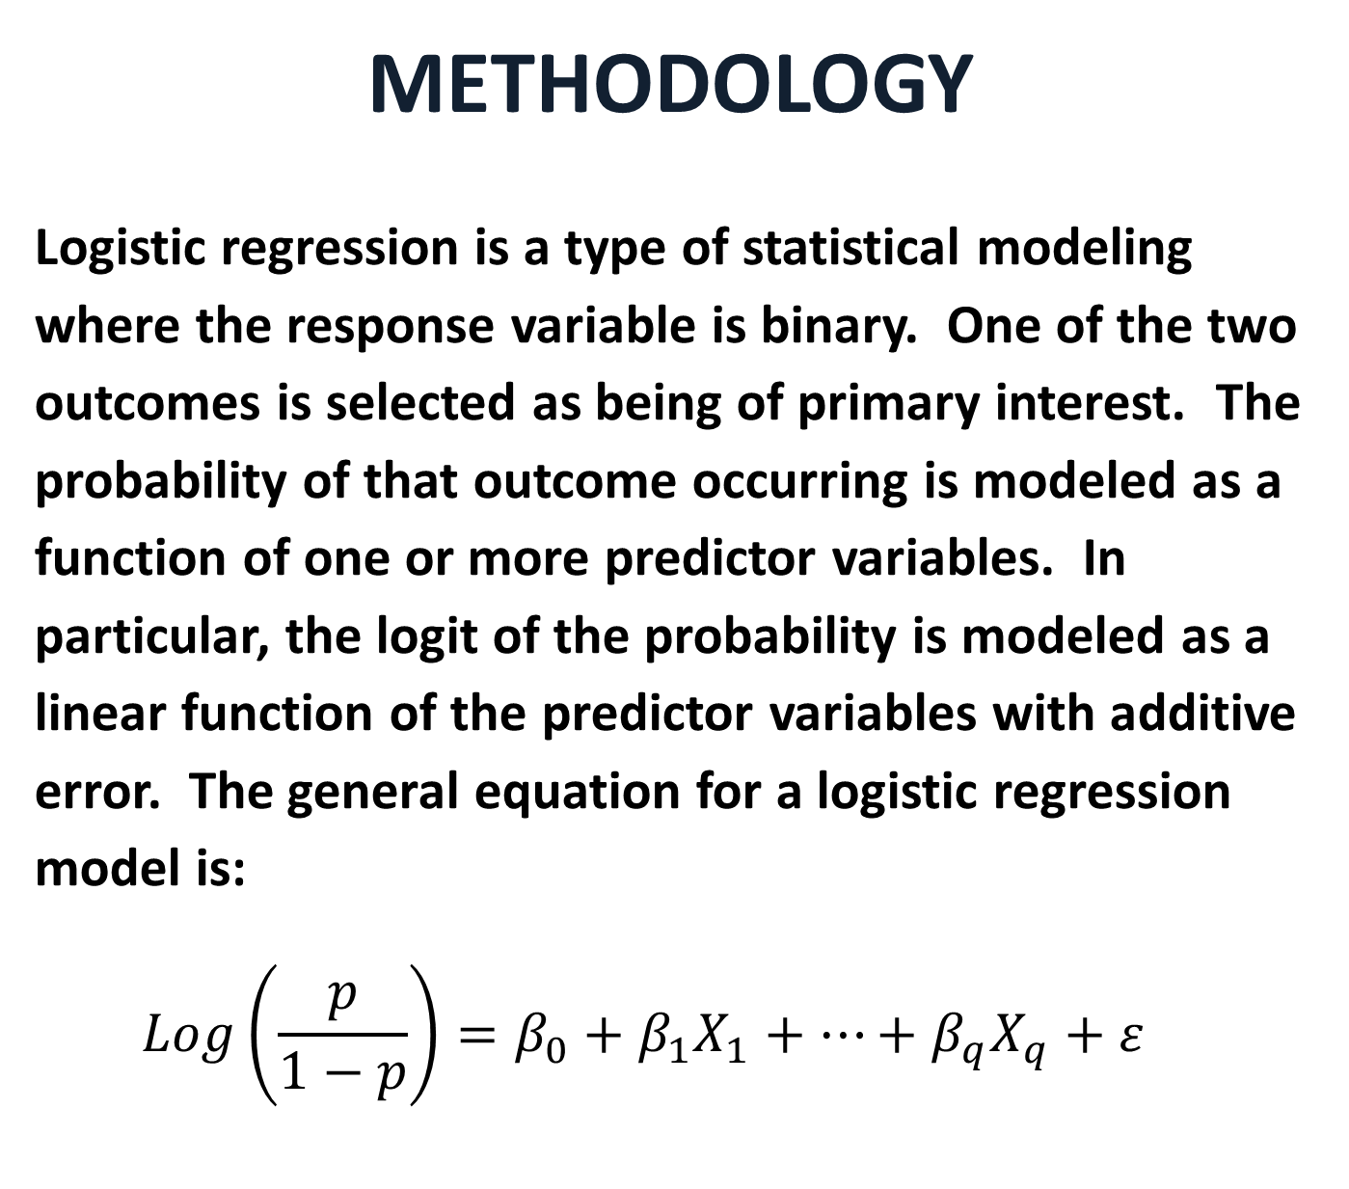
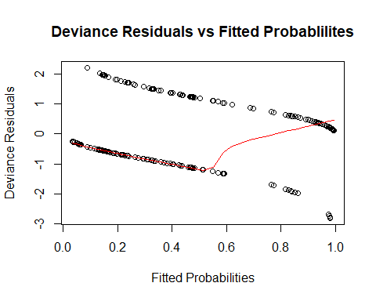
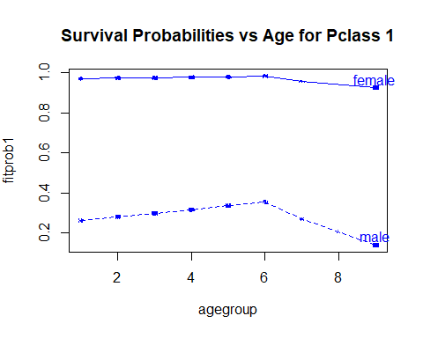
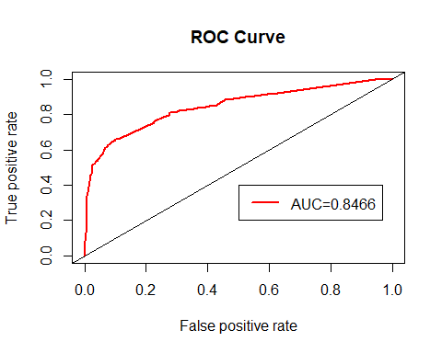
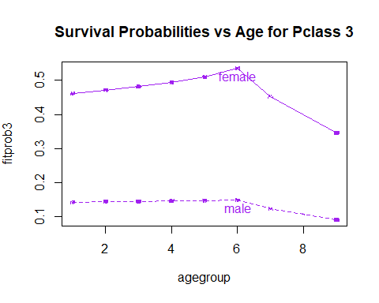
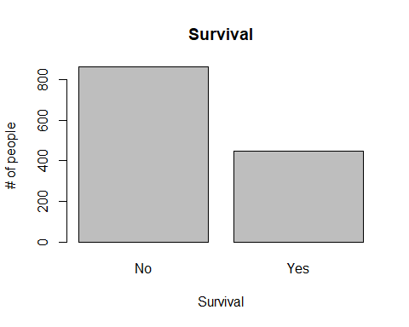
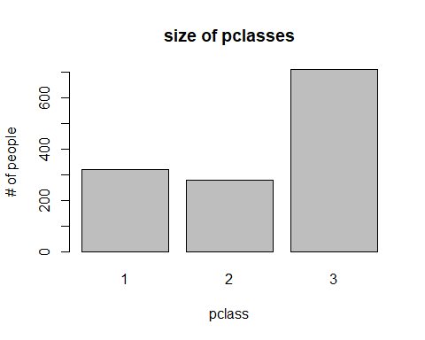
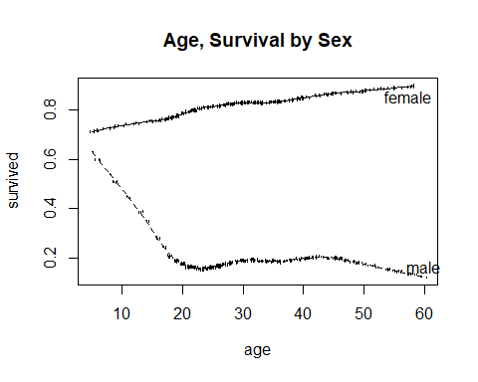
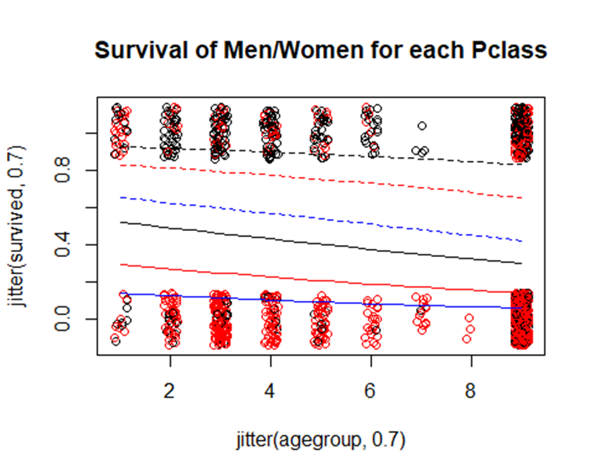
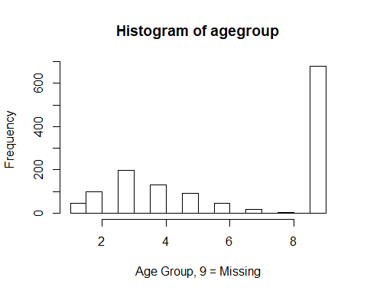
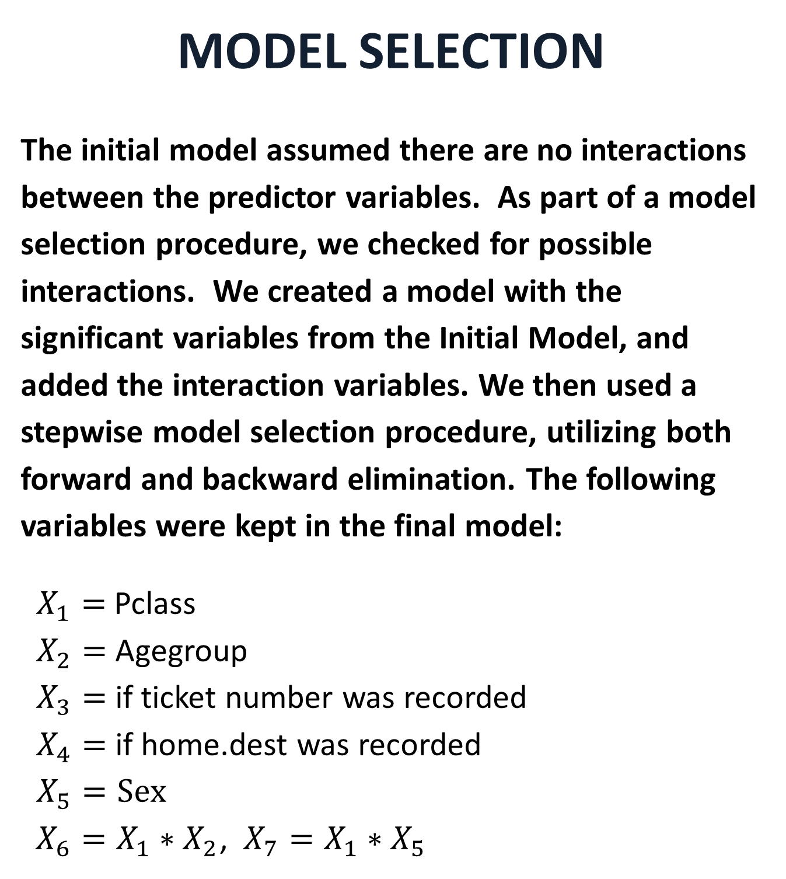
Analysis of Surviving the Titanic with Logistic Regression
Michael Streyle, Matthew Foundos, Carly Mester - Luther College
ABSTRACT
In this data set we are able to examine real life data from the passengers on the RMS Titanic which sank in 1912. The response variable for the data is the survival status of the passenger. The data provides us with 10 different variables, some of which include name, passenger class, age, and sex. Throughout our analysis, we are looking to explore a few questions - what type of passenger has the lowest chance of survival? What is the probability the average Luther student survives? By utilizing logistic regression, we hope to be able to answer these questions as well as find the best possible model for predicting survival.
DATA CHARACTERISTICS
Some key variables used in the analysis presented here:
Variable Name Description____________________
Agegroup 1-9, with 9 = missing values
Sex Gender of passenger
Pclass 1 = upper, 2 = middle, 3 = lower
Name_length Length of Passengers Name
Home.dest_rec 1 = yes, 0 = no for if destinations were recorded
____________________________________________________
MODEL SELECTION
The initial model assumed there are no interactions between the predictor variables. As part of a model selection procedure, we checked for possible interactions. We created a model with the significant variables from the Initial Model, and added the interaction variables. We then used a stepwise model selection procedure, utilizing both forward and backward elimination. The following variables were kept in the final model:
$X_{1}=$ Pclass $X_{2}=$ Agegroup $X_{3}=$ if ticket number was recorded $X_{4}=$ if home.dest was recorded $X_{5}=Sex$ $X_{6}=X_{1}∗X_{2}$, $X_{7}=X_{1}∗X_{5}$
MODEL DIAGNOSTICS
A plot of the deviance residuals vs. fitted values reveals no serious problems. The fitted Lowess line is ideally expected to be horizontal at zero.
INITIAL MODEL FIT
A first-order model of the data resulted in a model with many significant predictors as shown:
The p-value of our deviance test for lack of fit is .9999 when referring to our final model. This shows our model seems to fit really well. A receiver operating characteristic (ROC) curve analysis also confirms the ability of this model to predict survival. The ROC curve suggests the predictive ability of this model is better than random guessing, since the AUC is larger than 0.5. By examining the possible cutoff values, the cutoff that minimizes the distance from the curve to the top left corner (indicating a perfect model) is 0.326. With this cutoff, the sensitivity is 0.768 and the specificity is 0.766.
## Coefficients: ## Estimate Std. Error z value Pr(>|z|) ## (Intercept) 3.48189 0.75145 4.634 3.59e-06 *** ## pclass -0.88803 0.13334 -6.660 2.74e-11 *** ## name_length 0.02158 0.01093 1.974 0.048403 * ## as.factor(agegroup)2 -1.38126 0.45688 -3.023 0.002501 ** ## as.factor(agegroup)3 -1.85789 0.42477 -4.374 1.22e-05 *** ## as.factor(agegroup)4 -1.60327 0.43990 -3.645 0.000268 *** ## as.factor(agegroup)5 -2.16478 0.46884 -4.617 3.89e-06 *** ## as.factor(agegroup)6 -2.29185 0.55853 -4.103 4.07e-05 *** ## as.factor(agegroup)7 -4.00577 0.83961 -4.771 1.83e-06 *** ## as.factor(agegroup)8 -15.77621 494.36448 -0.032 0.974542 ## as.factor(agegroup)9 -1.67688 0.43391 -3.865 0.000111 *** ## ticket_rec 0.74818 0.36488 2.050 0.040316 * ## room_rec 0.41567 0.34000 1.223 0.221500 ## as.factor(embarked)Cherbourg -0.35570 0.38808 -0.917 0.359362 ## as.factor(embarked)Queenstown -0.68641 0.52501 -1.307 0.191067 ## as.factor(embarked)Southampton -0.71985 0.36823 -1.955 0.050595 . ## home.dest_rec 1.17255 0.34816 3.368 0.000758 *** ## as.factor(sex)male -2.38233 0.16863 -14.127 < 2e-16 ***
We opted to use the ticket_rec, room_rec, and home.dest_rec variables because they are all factor variables with a large number of levels, and we wanted to keep our degrees of freedom as high as possible. Also, these variables did not seem like they would logically be very significant, and home.dest has formatting inconsistencies. We also thought that these variables may not have been very accurately recorded. The most significant variables in the first order model are agegroup, sex, pclass, and if the home.dest is recorded. By exponentiating the coefficients, we can obtain odds ratios which become easier to interpret.
Plot the initial models:
Final model parameter estimates:
CONCLUSIONS
We can see from all of our models that an elderly male who traveled in third class would have the smallest chance of survival.
The 'average' Luther student is a female in her 20's from either the first or second passenger class (using the term average very loosely here).
Using our reduced model (survived ~ agegroup + pclass + sex), we determined the average Luther student would probably survive. If the student decided to spend extra and get a first class ticket, our model predicts their probability of survival is 0.908 and if they buy a second class ticket, their probability of survival is 0.793. Both are well above 0.5, as well as far above our 0.326 cutoff.
 | Estimate | Error | Z value | Pr(>|z|) | Significance
(Intercept) | 5.64192 | 0.85895 | 6.568 | 5.09e-11 | ***
Pclass | -2.04536 | 0.32453 | -6.303 | 2.93e-10 | ***
Agegroup | -0.21154 | 0.09520 | -2.222 | 0.0263 | *
ticket_rec | 0.92693 | 0.36400 | 2.546 | 0.0109 | *
as.factor (embarked) Cherbourg | -0.63920 | 0.44881 | -1.424 | 0.1544
as.factor (embarked) Queenstown | -1.08677 | 0.56154 | -1.935 | 0.0529 | .
as.factor(embarked)Southampton | -1.07943 | 0.44438 | -2.429 | 0.0151 | *
home.dest_rec | 1.52433 | 0.37508 | 4.064 | 4.82e-05 | ***
as.factor(sex)male | -5.66767 | 0.60483 | -9.371 | < 2e-16 | ***
pclass:agegroup | 0.06309 | 0.04318 | 1.461 | 0.1440
pclass:as.factor(sex)male | 1.34630 | 0.23203 | 5.802 | 6.54e-09 | ***
In order to plot our model with the data, we reduced it to a model containing only agegroup, sex, and pclass. In the graph, the solid lines represent men and the dotted lines represent women. For both men and women, black is 1st class, red is 2nd class, and blue is 3rd class. The black data points are female and the red data points are male.

